Slide 1
(Co)nfiguration (M)odules for (P)ower industry (A)utomation (S)ystems Roadmap presentation to CEATI’s Protection & Control Program

Slide 2


About Me
Ing Sander Jansen
Data architect @ Alliander
Involved in applying
IEC CIM
IEC 61850
Notes:
Talking Points:
- LF Energy is taking the power of Linux and focusing it on energy
But why do we exist?
Because in energy we now face similar conditions as those examples we discussed in the private sector.
We now must exist in an open source economy

Slide 3

The world around energy has changed.
Notes:
Talking Points:
Disruption is what happens to people who don’t forecast what’s about to happen.
Transformation is better.
- The world around energy has changed
- It’s simultaneously opening opportunities like we’ve never seen before for those that change with it, as it rapidly erodes the relevance of those that don’t embrace the change
- We’ve seen it in other industries and no one in the energy industry is immune to the change that is happening in our industry.

Slide 4
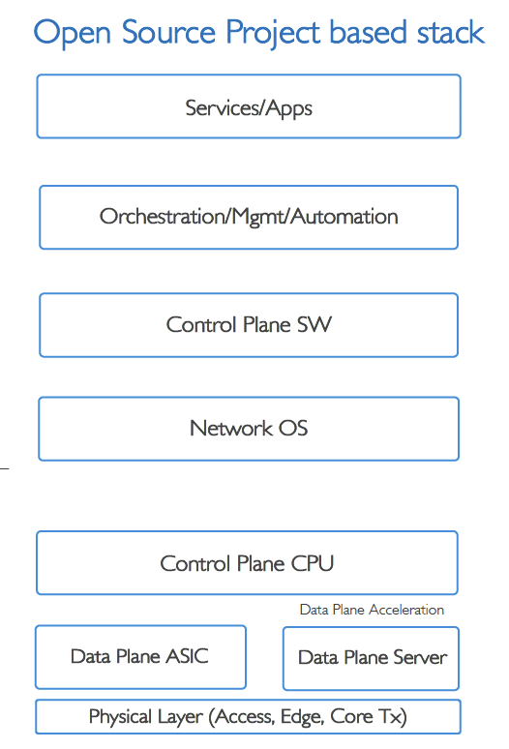
Direction of digitalization (Generic)
Today’s Black Box
Proprietary
Market Disruption
Driving Innovation
Open Source Project Based Stack
Orchestration
Management
Virtual Functions
Automation
Software-Defined
Disaggregation
Features/Service Mgmt & Ops
Control software Operating System
Software
Control Plane CPU
Switch Silicon
Data Plane Silicon
Hardware
Notes:
Virtual Functions
Ability to run applications & services in software over generic hardware versus purpose build appliance hardware
Automation
Zero Touch Operations – design, policy, orchestration, management and runtime operations with closed loop control
Software-Defined
Separation of Control plane ie where traffic should go from Data plane – actual traffic forwarding
Disaggregation
Ability to separate hardware from software – other term white-boxes

Slide 5

CoMPAS Overiew
IEC 61850 (profile management) and configuration tool:
multi-vendor and multi-end-user development resources and 61850 competences to accelerate
promote top-down configuration processes
production grade and reference implementation
configurable implementation
develop open source software components
Notes:
The aim of the CoMPAS project is to develop open source software components related to IEC 61850 model implementation (profile management) and configuration of a power industry Protection Automation and Control System (PACS).
This open source initiative will:
leverage multi-vendor and multi-end-user development resources and 61850 competences to accelerate the development of common software blocks
promote top-down configuration processes and common model implementation choices (thus also accelerate the conformity to IEC 61850 through software implementation)
The project should not duplicate works already carried out in standardization groups. Instead it should aim at delivering a production grade and reference implementation of the standard. When the rules and principles from the standard are not comprehensive enough or subject to interpretation or still work in progress, the project may have to take choices for the implementation. In such case it should strive to a configurable implementation.

Slide 6

History of the project
Aug. 2019
Nov. 2019
Apr. 2020
May 2020
Sept. 2020
Design Team formed to draft the Roadmap of an o/s project on IEC-61850 system configuration
CoMPAS project organization live and starting to work
Design team: Alliander, GE, National Grid, OSIsoft, RTE, Schneider Electric, TenneT.
Call for collaboration on Digital Substation related projects under LF Energy umbrella
Approval and launch of CoMPAS project
Another Design Team formed to draft the Roadmap of an o/s project on substation automation virtualization

Slide 7
Main use cases
Grid planning to IEC 61850 design
Requirements specification
Changing configurations
Asset management activities
Publish configurations for interested (internal) collegues
CoMPAS facilitates in
Improve through higher automation the interlinkage between grid planning and PACS engineering processes
Improve through higher automation the interlinkage between the configuration of PACS and the configuration of central systems (SCADA, asset management)
© 2019-2020 Alliander, GE, National Grid, OSIsoft, RTE, Schneider Electric, TenneT.
Licensed under Creative Commons Attribution 4.0 International (CC BY 4.0)
Notes:
Tools for IEC 61850 profile management and configuration are needed at various business processes of the power grid industry
When planning grid infrastructure in order to facilitate the design of power system adaptations and the engineering of substation PACS to be installed or upgraded
During PACS procurement and delivery phase in order to specify the requirements and perform multi-vendor system integration and commissioning
During the operational live of PACS in order to adapt to changes in operational conditions and to perform system configuration updates
For asset management activities in order to perform maintenance actions and PACS upgrades
Additionally, there is a demand for better availability of Substation PACS data at enterprise level (functions & settings, operational process data) and for enhanced interoperability between processes at substation and enterprise levels:
Improve through higher automation the interlinkage between grid planning and PACS engineering processes
Improve through higher automation the interlinkage between the configuration of PACS and the configuration of central systems (SCADA, asset management)

Slide 8
Core functions for profile management and configuration tools
The main functional blocks required in order to address the needs:
System configuration: “System Specification Description (SSD)”
“Substation Configuration Description (SCD)” conversion
IEC61850 profile management:
logical device/function builder,
library of common profiles for usual functions,
versioning, definition of reusable user profile of IEC 61850 data model
Conformity verification of System Configuration description Language (SCL) files
API to vendor specific “IED Capability Description (ICD)” tools
ICD conformity check
ICD compatibility management
ICD versioning / repository
Notes:
The main functional blocks required in order to address the needs previously described (and therefore to be included in the roadmap) are:
System configuration: “System Specification Description (SSD)” to “Substation Configuration Description (SCD)” conversion, PACS policy registry (scripts?), API to vendor specific IED configurators
IEC61850 profile management: logical device/function builder, library of common profiles for usual functions, versioning, definition of reusable user profile of IEC 61850 data model (potentially continue/restart ENTSO-E profiling tool)
Conformity verification of System Configuration description Language (SCL) files
System specification: profile to “System Specification Description (SSD)” conversion, PACS policy registry (scripts?), API to vendor specific “IED Capability Description (ICD)” tools, ICD conformity check, ICD compatibility management, ICD versioning / repository
Availability of Substation PACS data at enterprise level (Functions & settings, operational process data)

Slide 9
IEC61850-CIM mapping functions
In order to fulfill the need for enhanced interoperability between processes at substation and enterprise levels, the roadmap of the project should also include the development of mapping functions between CIM and 61850. The mapping functions to be developed should be automatic, configurable and bidirectional.
CIM and IEC 61850 are both based on XML file for representation of a configuration. Automatic rules could be derived from the standard based on which open source transformations could be developed.
Transformations will have to focus not only on XML but also on semantic of data
Transformations are needed both ways (from IEC 61850 to CIM and from CIM to IEC 61850)
IEC 62361-102 based
Notes:
In order to fulfill the need for enhanced interoperability between processes at substation and enterprise levels, the roadmap of the project should also include the development of mapping functions between CIM and 61850.
New standard IEC 62361-102 provides recommendation to both CIM and IEC 61850 groups to improve both standards’ cross-compatibility
But the standard 62361-102 focuses only on one way: IEC CIM configuration from IEC 61850
The mapping functions to be developed should be automatic, configurable and bidirectional.
CIM and IEC 61850 are both based on XML file for representation of a configuration. Automatic rules could be derived from the standard based on which open source transformations could be developed.
Transformations will have to focus not only on XML but also on semantic of data
Transformations are needed both ways (from IEC 61850 to CIM and from CIM to IEC 61850)

Slide 10
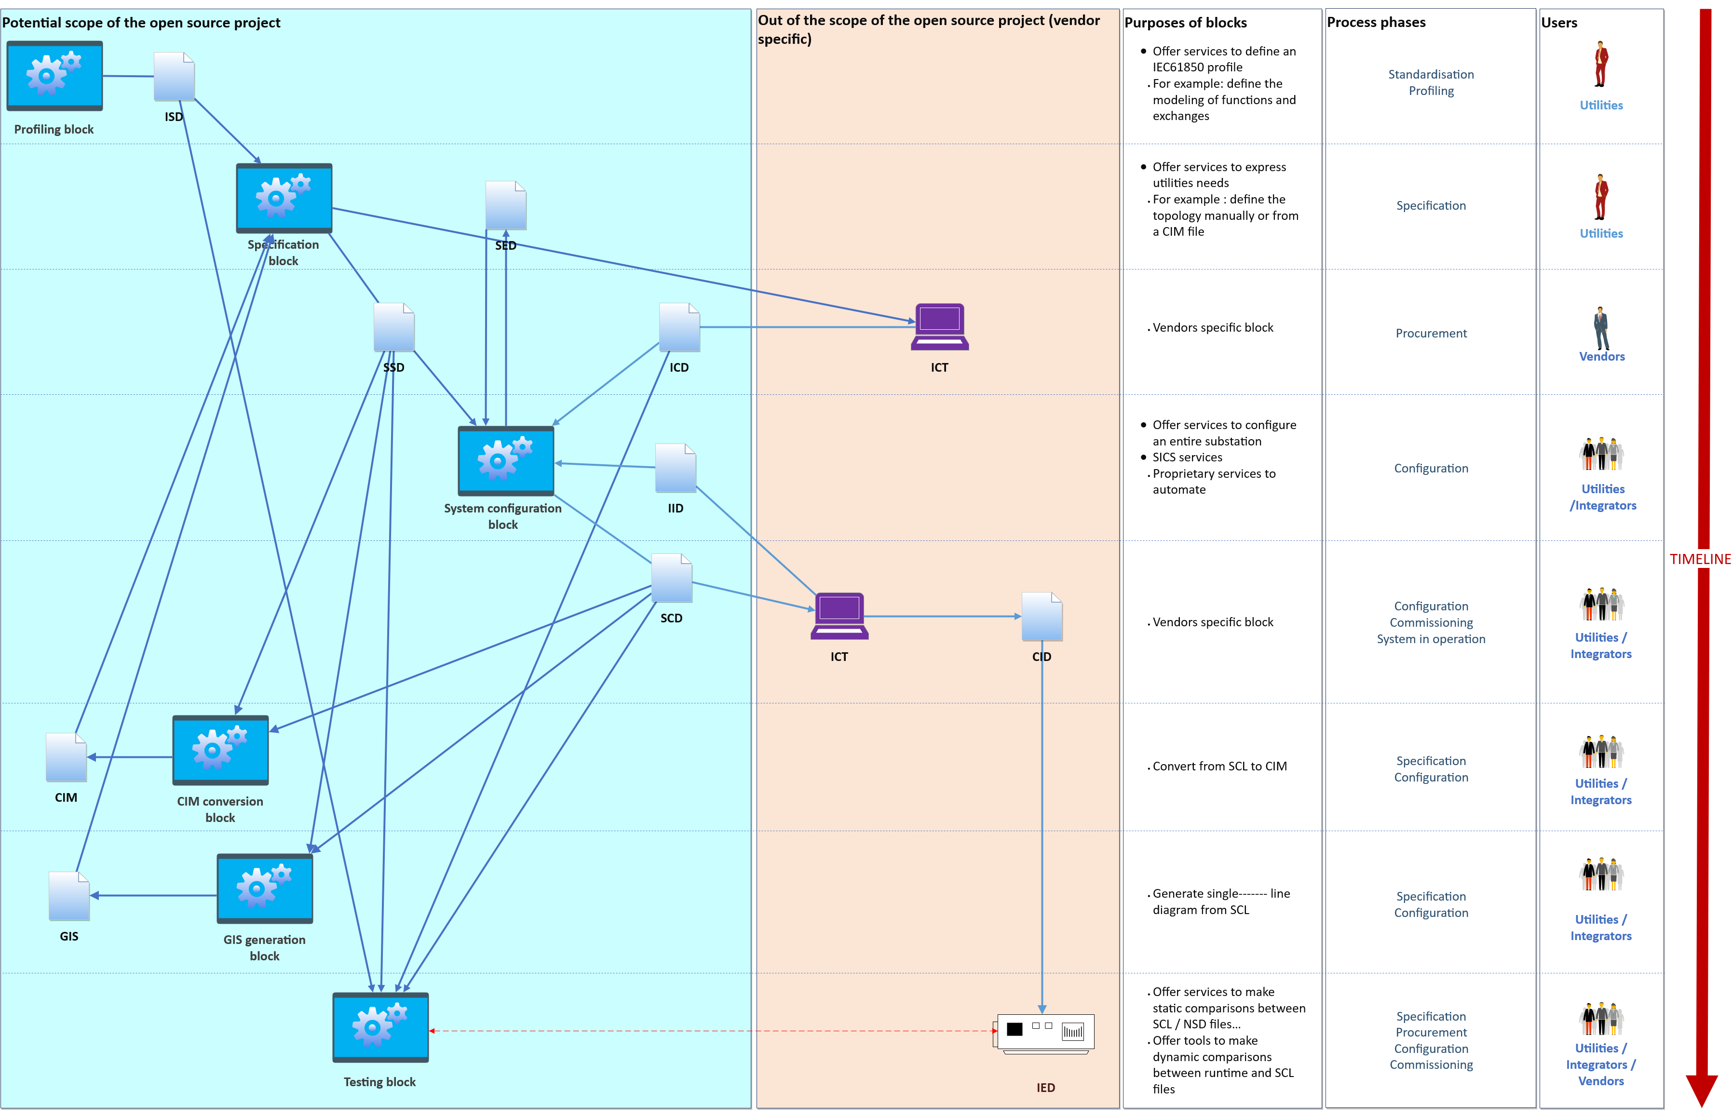
Functional block diagram

Slide 11
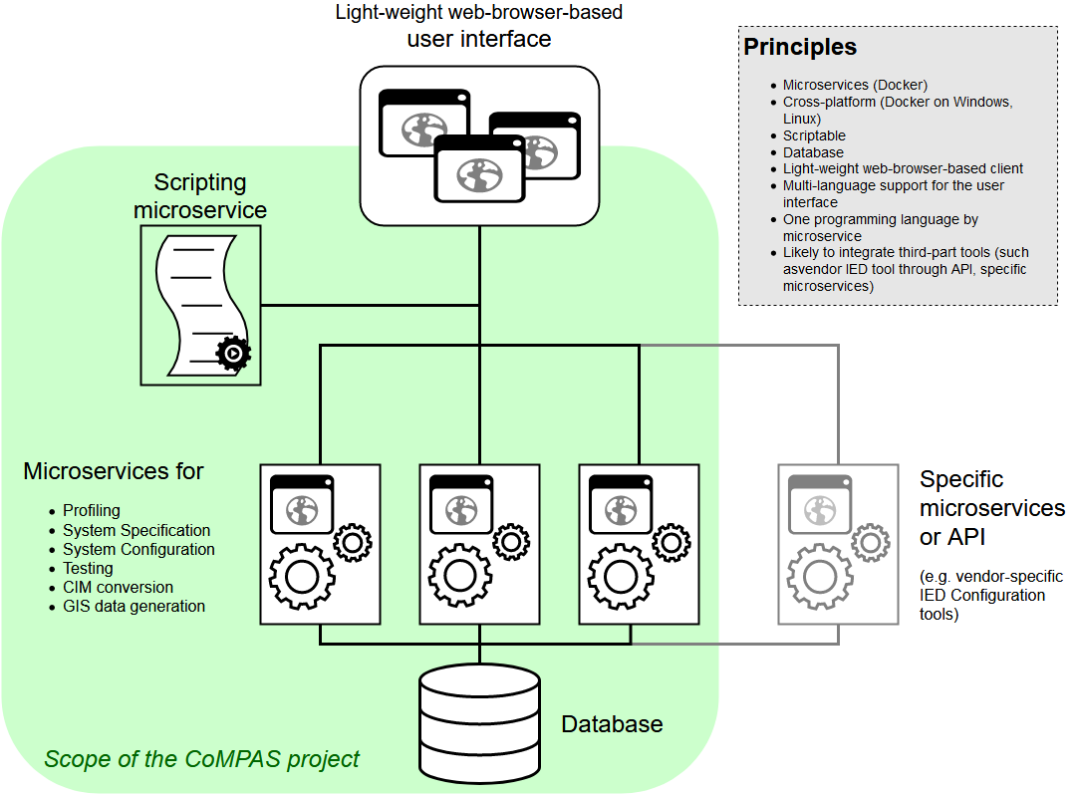
Architecture overview

Slide 12
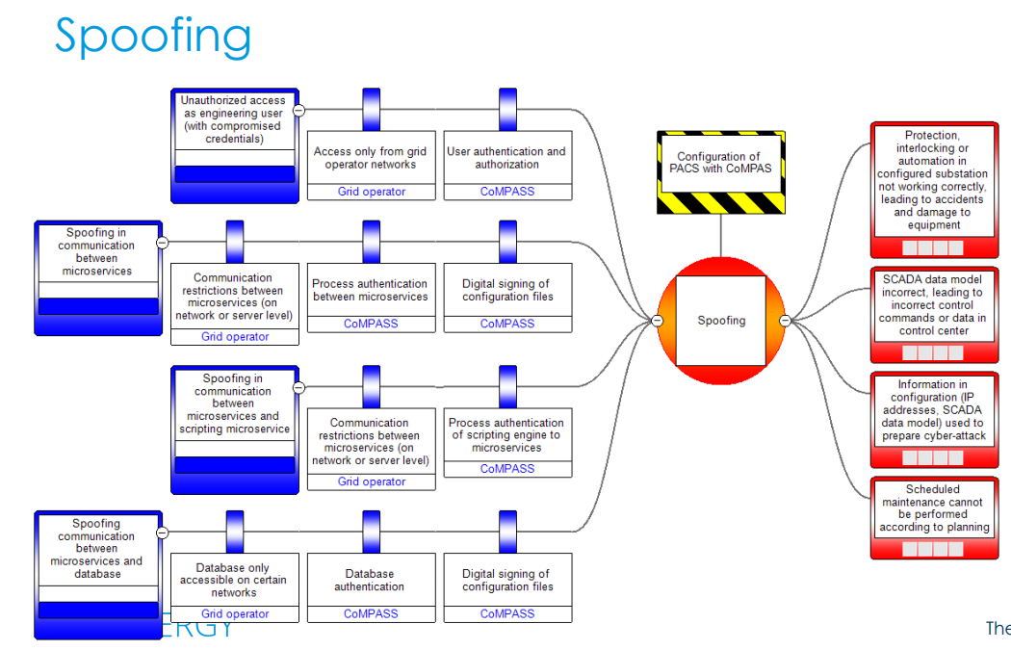
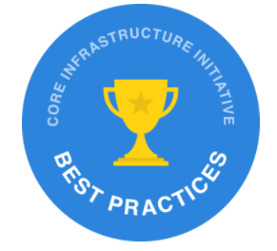
CoMPAS security is important
Notes:
In order to fulfill the need for enhanced interoperability between processes at substation and enterprise levels, the roadmap of the project should also include the development of mapping functions between CIM and 61850.
New standard IEC 62361-102 provides recommendation to both CIM and IEC 61850 groups to improve both standards’ cross-compatibility
But the standard 62361-102 focuses only on one way: IEC CIM configuration from IEC 61850
The mapping functions to be developed should be automatic, configurable and bidirectional.
CIM and IEC 61850 are both based on XML file for representation of a configuration. Automatic rules could be derived from the standard based on which open source transformations could be developed.
Transformations will have to focus not only on XML but also on semantic of data
Transformations are needed both ways (from IEC 61850 to CIM and from CIM to IEC 61850)

Slide 13
Priorities at the launch of the project for the development of a Minimum Viable Product
Functional block / workstream | Priority rank | Comment
Reference architecture | 1 | Confirmed as priority for MVP
System Configuration | 1 | Confirmed as priority for MVP
Testing | 2 | Pending commitment of resources (assumed to happen Q3 2020)
IEC61850-CIM mapping | 2 | Pending commitment of resources (assumed to happen Q3 2020)
System specification | 3
Profiling | 3
© 2019-2020 Alliander, GE, National Grid, OSIsoft, RTE, Schneider Electric, TenneT.
Licensed under Creative Commons Attribution 4.0 International (CC BY 4.0)

Slide 14
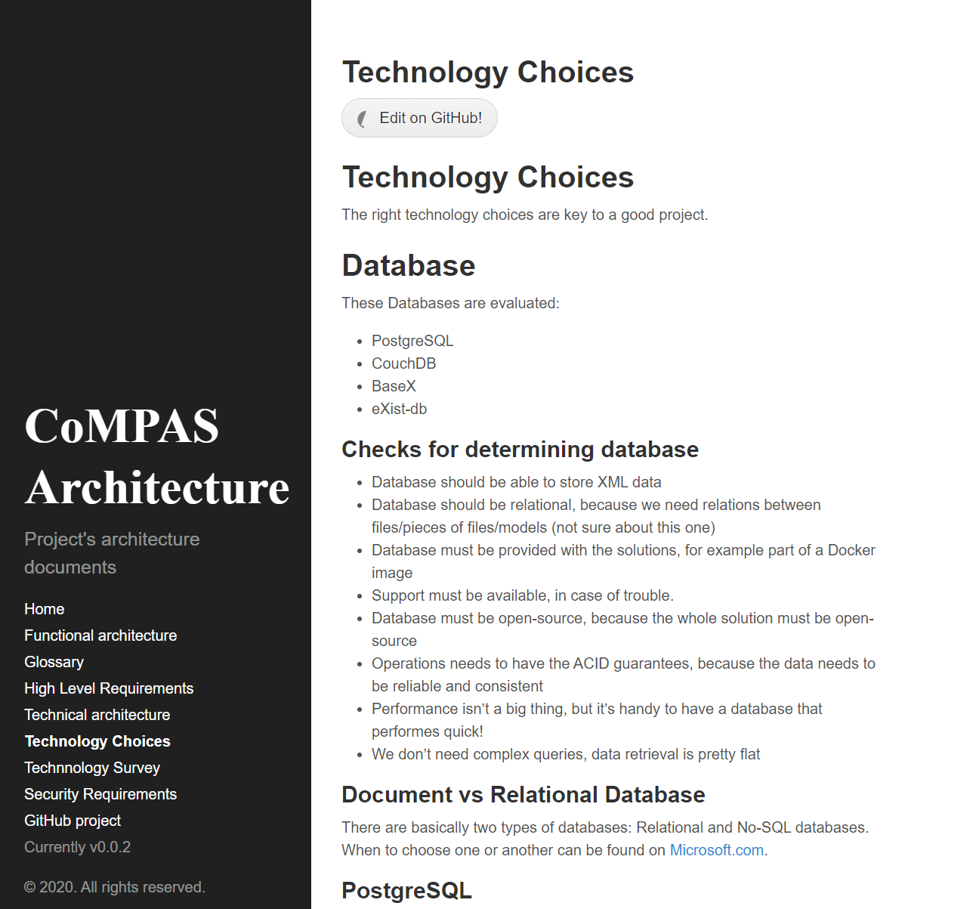
CoMPAS current status
Architecture focus:
Database
Microservices technology
XML processing
Notes:
In order to fulfill the need for enhanced interoperability between processes at substation and enterprise levels, the roadmap of the project should also include the development of mapping functions between CIM and 61850.
New standard IEC 62361-102 provides recommendation to both CIM and IEC 61850 groups to improve both standards’ cross-compatibility
But the standard 62361-102 focuses only on one way: IEC CIM configuration from IEC 61850
The mapping functions to be developed should be automatic, configurable and bidirectional.
CIM and IEC 61850 are both based on XML file for representation of a configuration. Automatic rules could be derived from the standard based on which open source transformations could be developed.
Transformations will have to focus not only on XML but also on semantic of data
Transformations are needed both ways (from IEC 61850 to CIM and from CIM to IEC 61850)

Slide 15
Project leadership
CoMPAS Technical Steering Committee members:
Frédéric Fousseret (RTE)
Norbert Armand (GE)
Sander Jansen (Alliander)
Mohamed Sylla (RTE)
Rob Tjalma (Alliander)
Stevan Vigouroux (GE)

Slide 16
Relevant project links
Website: https://www.lfenergy.org/projects/compas/
Architecture: https://com-pas.github.io/compas-architecture/
General discussion mailing list: https://lists.lfenergy.org/g/CoMPAS
Source code work-in-progress on GitHub: https://github.com/com-pas/
Live chat on Slack: https://lfenergy.slack.com/archives/C01926K9D39

Slide 17







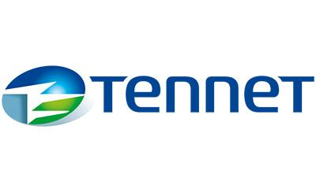





















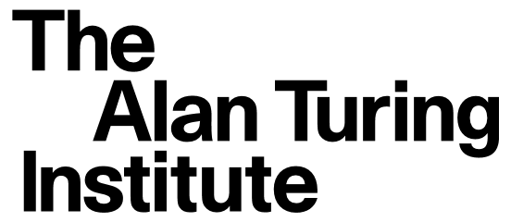




LF Energy Members
Strategic Members
General Members
Associate Members

Slide 18


OUR COMMITMENT
To achieve our climate and energy transition goals we have joined together to create a common functional architecture defining a fit-for-the-future grid. Our goal is a common understanding of required functional capabilities. The architecture starts with a top-level view and progresses to a finer granularity. The final slide shows existing and near-future LF Energy projects fits into this architecture.
This is a start. We want your feedback and involvement. With this we proclaim a commitment under LF Energy to find shared strategic dependencies. By utilizing open source we can accelerate a technology revolution that enables rapid decarbonization by digitalizing the global energy grid. We see that cooperation and working together is the only path to individual and collective success.
Join us.

